Slide 1
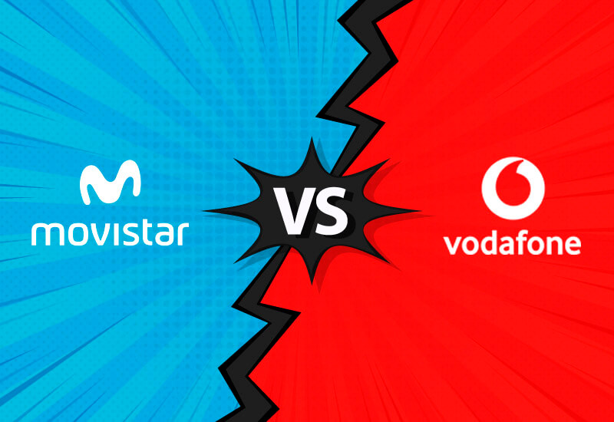
8 Golden Rules of interface design
Movistar vs Vodafone
Alejandro Bolaños García Raúl Rivero Sánchez

Slide 2
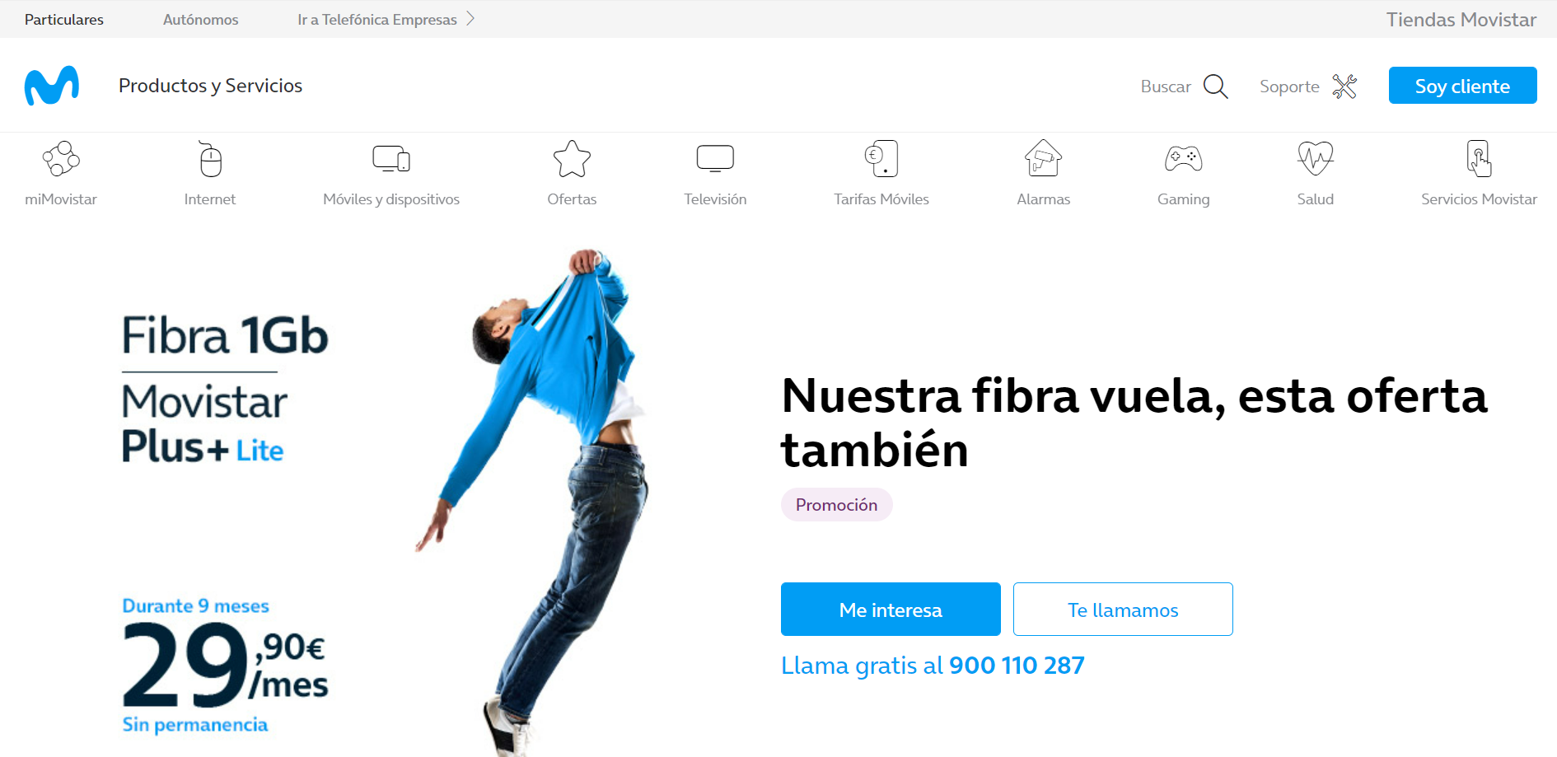
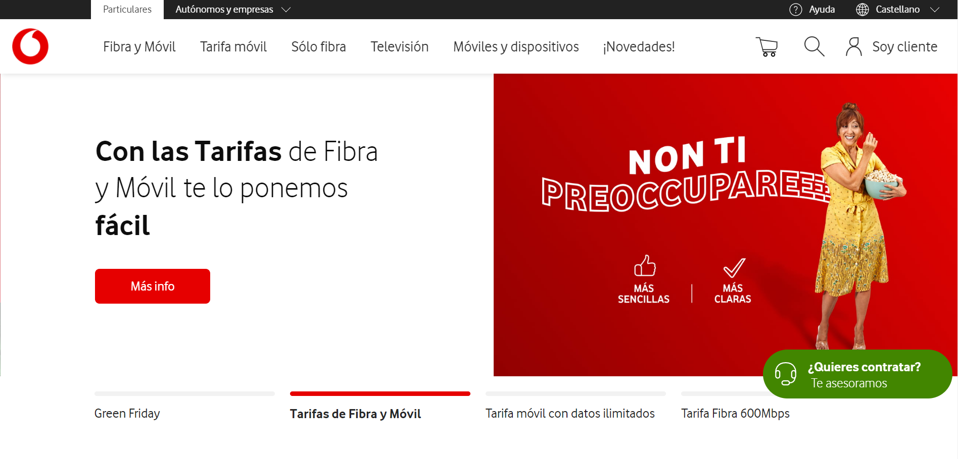




Strive for Consistency

Slide 3
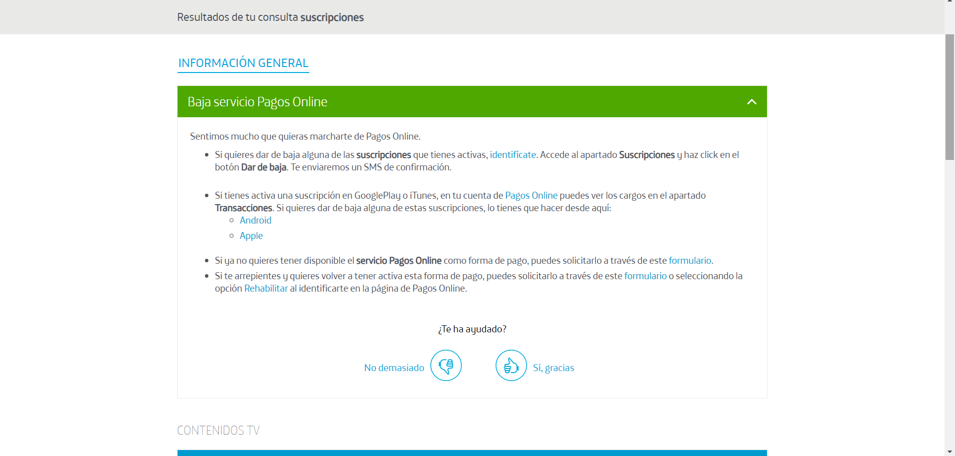
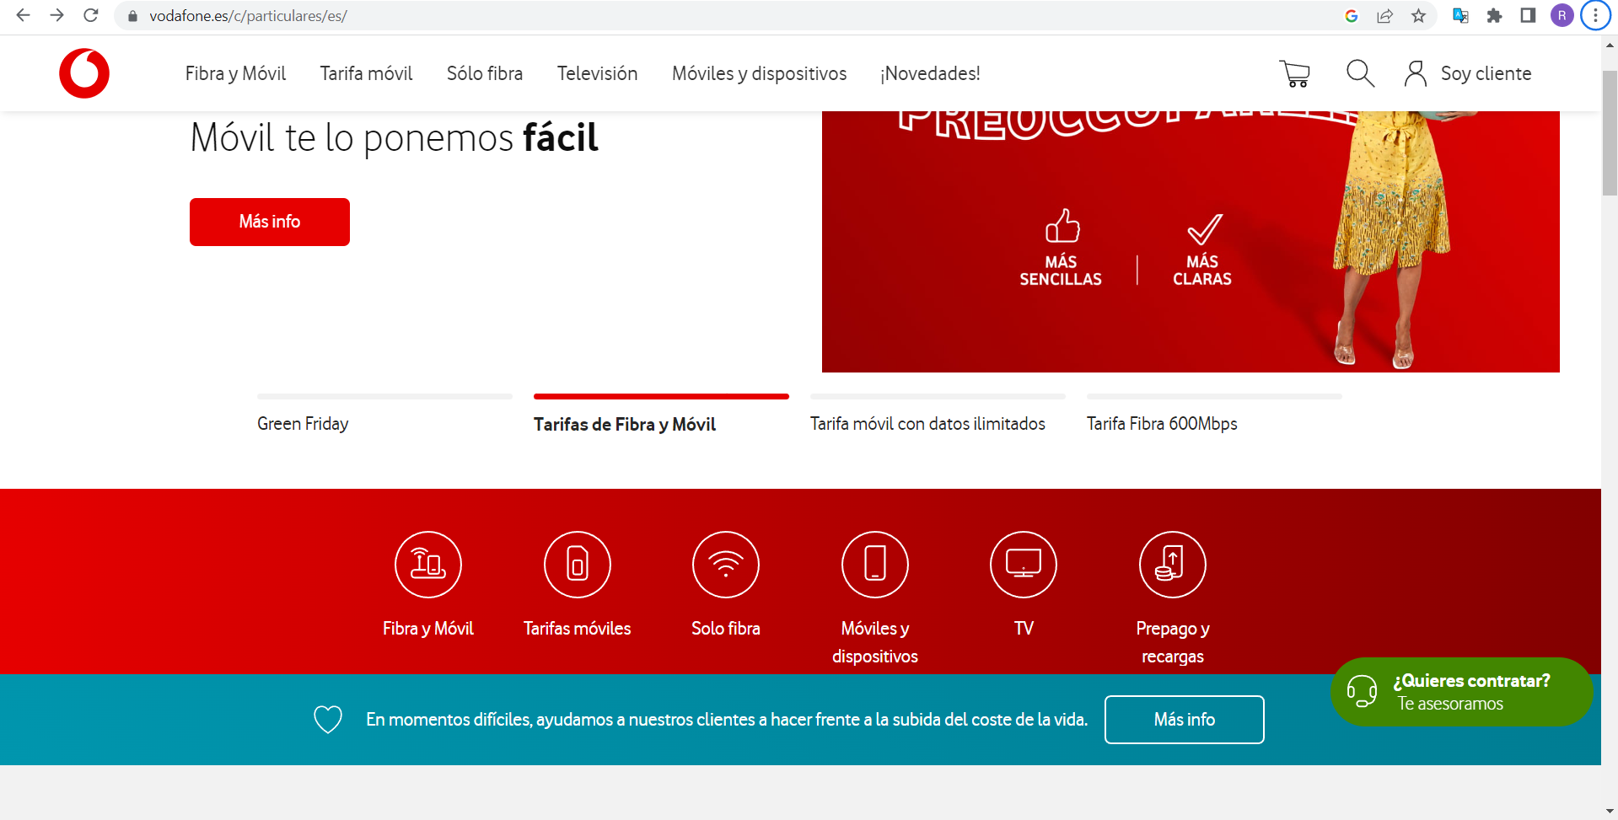
2. Seek Universal Usability

Slide 4
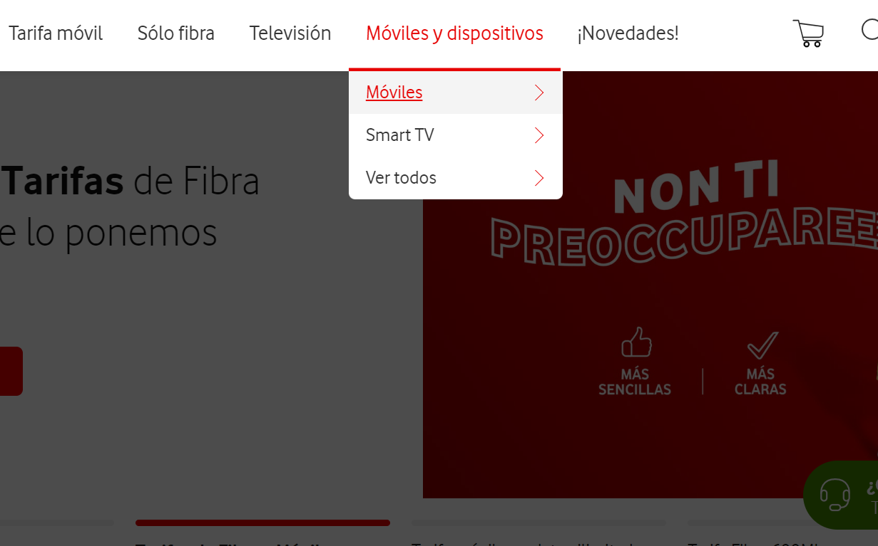
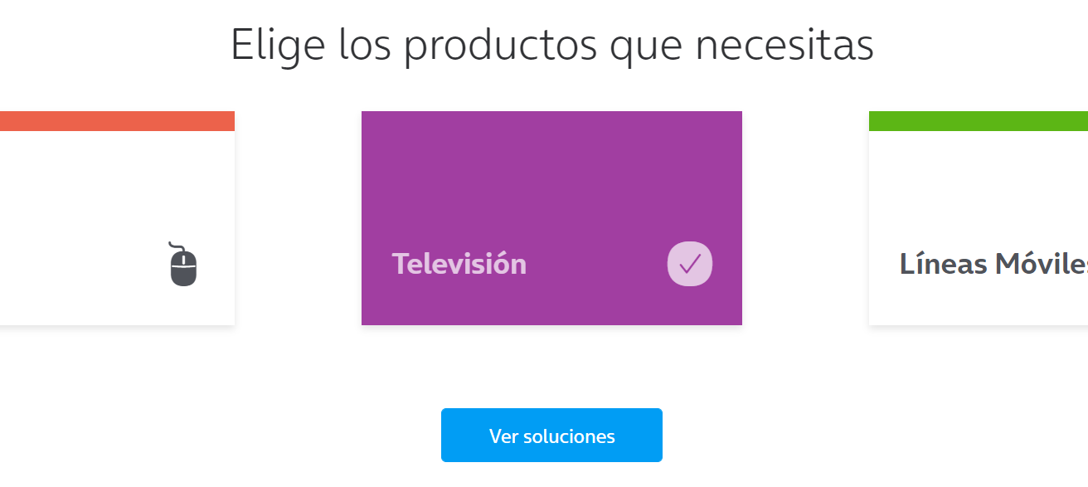
3. Offer informative feedback

Slide 5
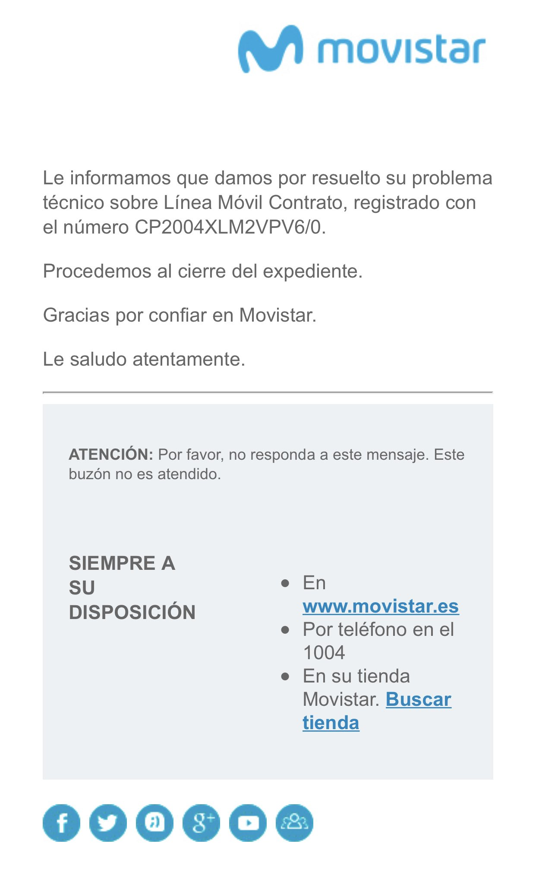
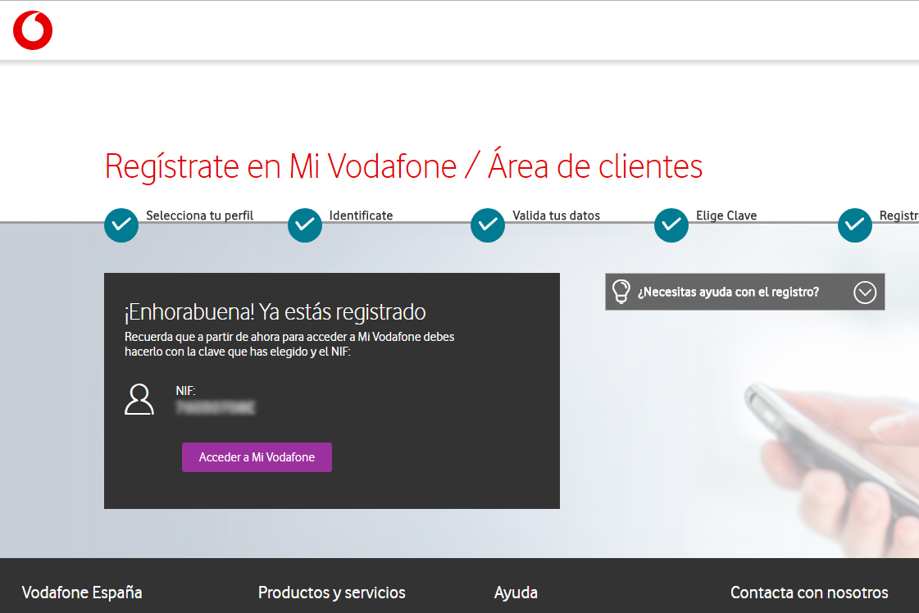
4. Design Dialogues to yield Closure

Slide 6
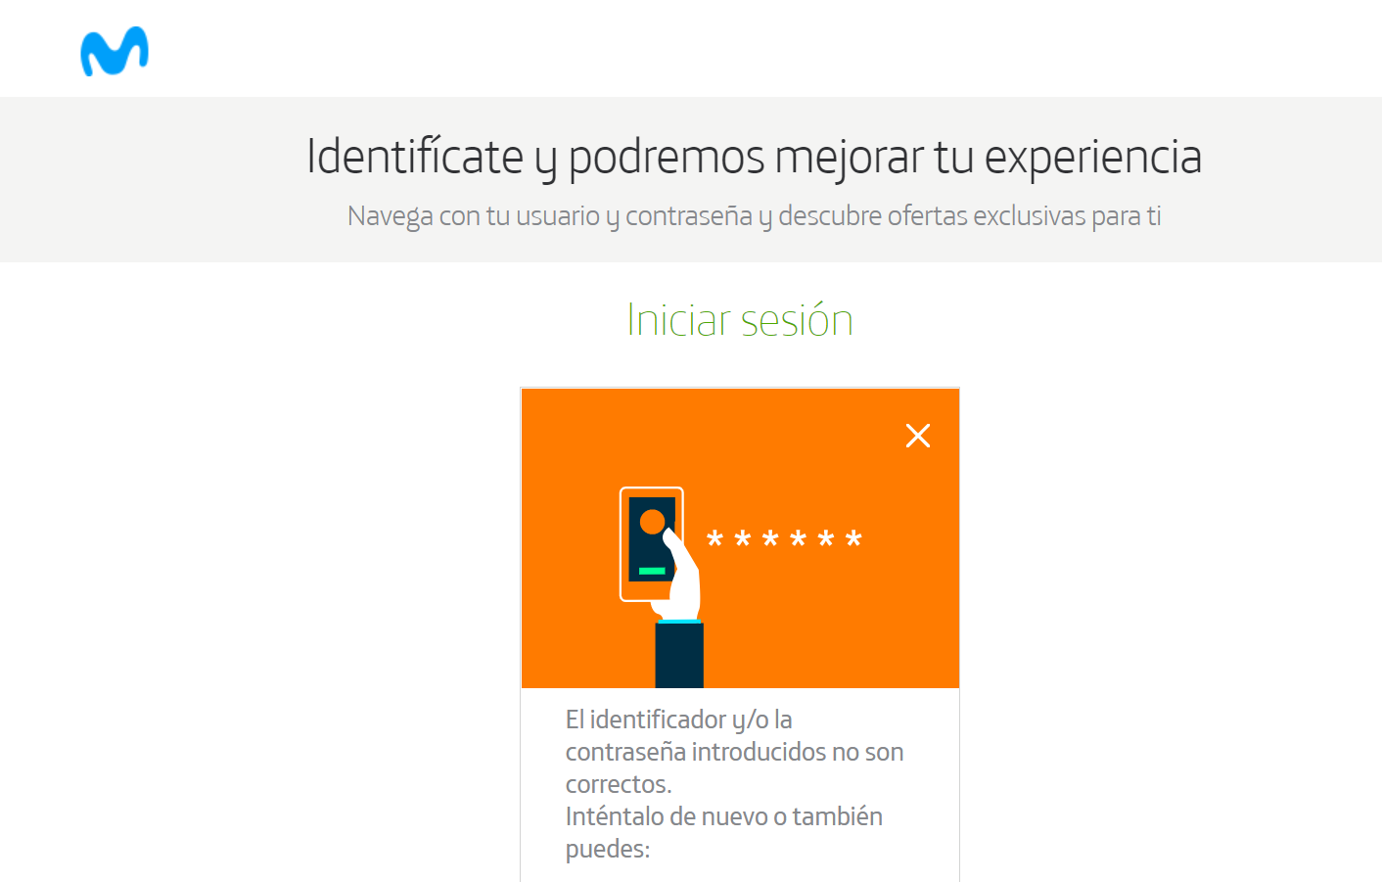
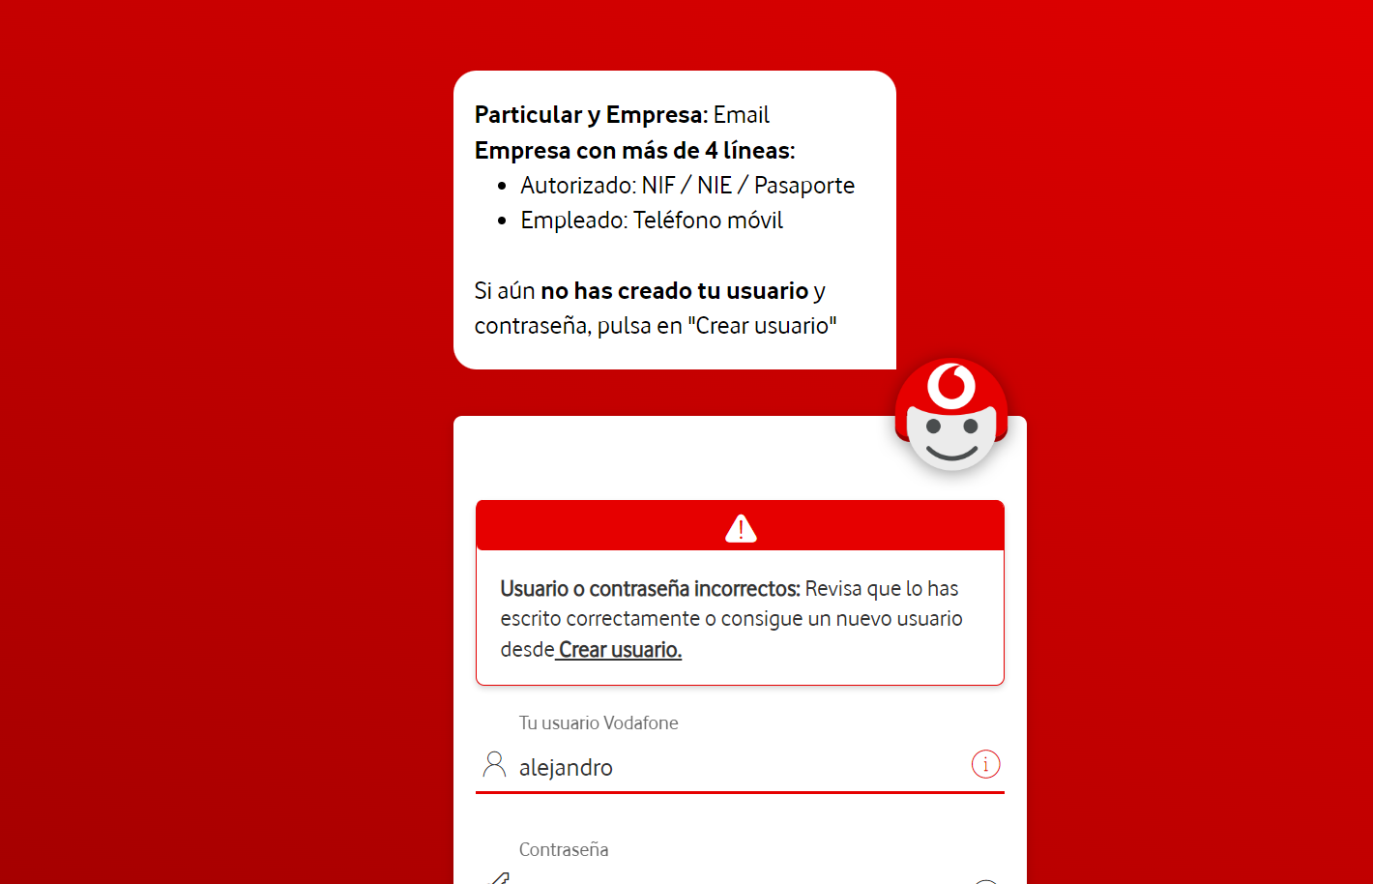
5. Prevent errors

Slide 7
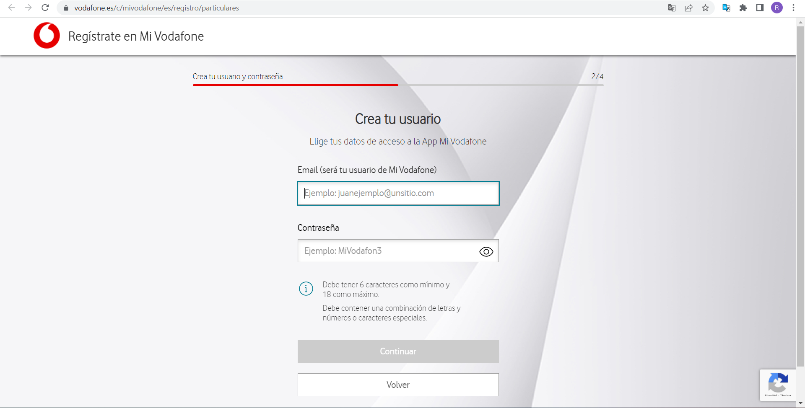
6. Permit Easy Reversal

Slide 8
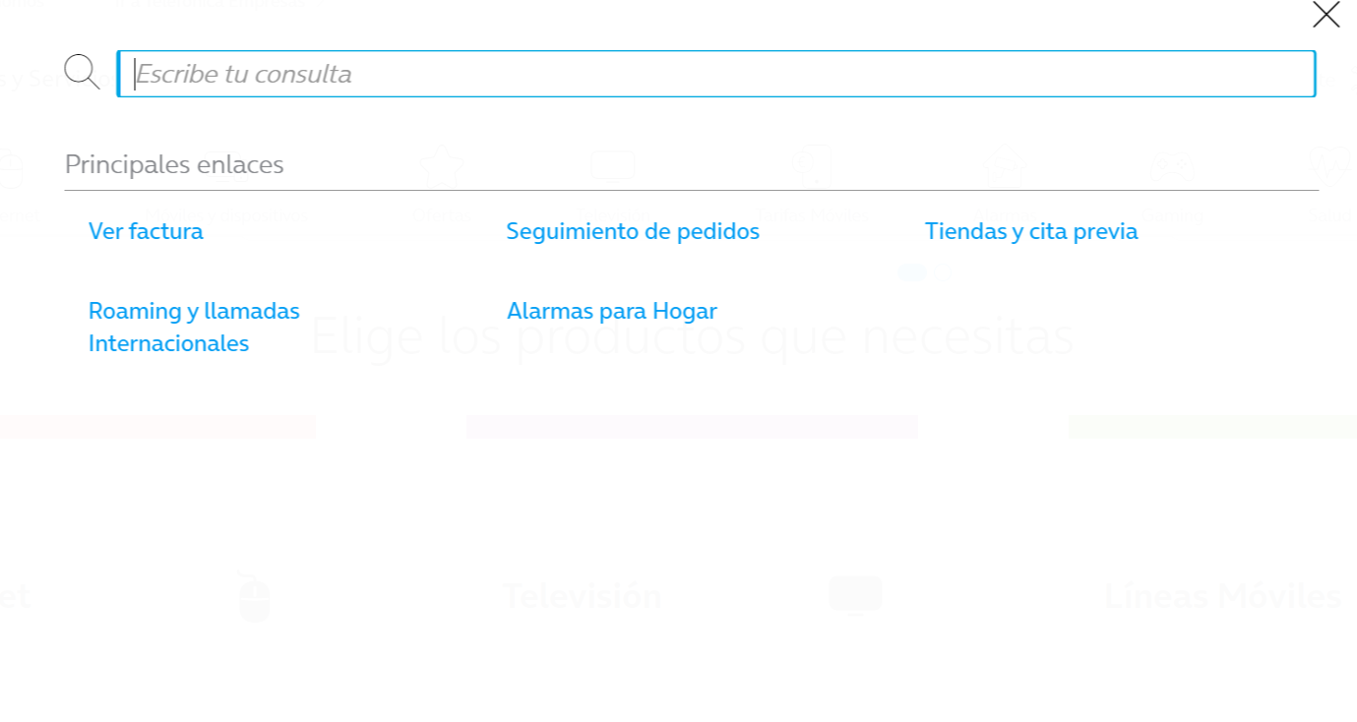
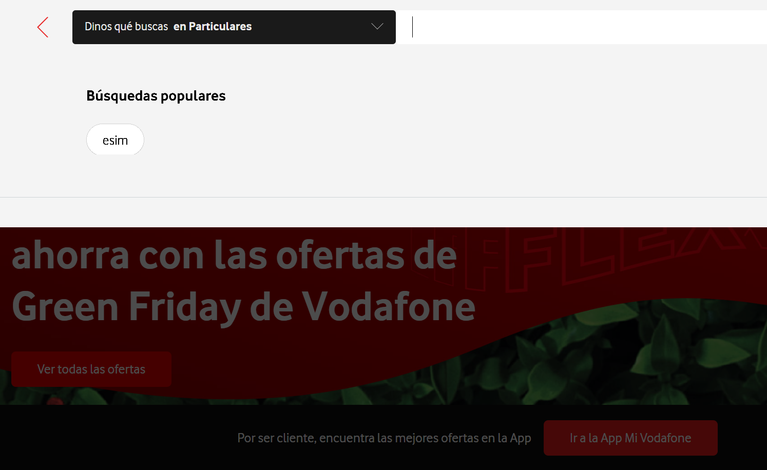
7. Keep users in control

Slide 9
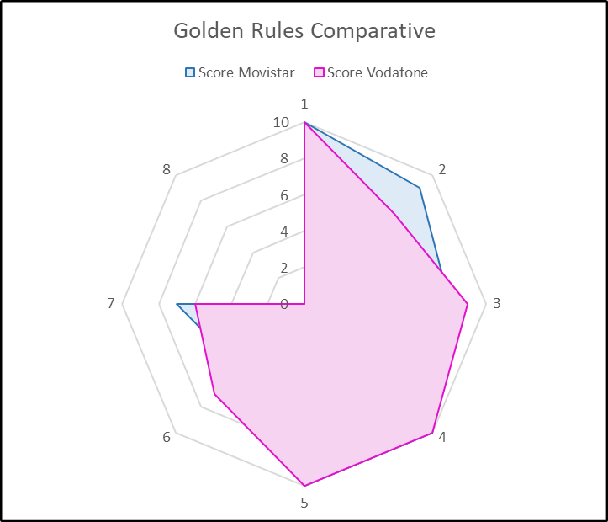
Diagrama de kiviat
As we see in the diagram, Vodafone offers a better website than Movistar but they are quite close.

Slide 10

System Usability Scale Test
Since the SUS score of movistar.es is above 68, it would be considered above average, so it is considered a good page.

